Slide 1
C++ Polymorphism
Kusal Bista

Slide 2
C++ polymorphism
The word polymorphism means having many forms.
In simple words, we can define polymorphism as the ability of a message to be displayed in more than one form.

Slide 3
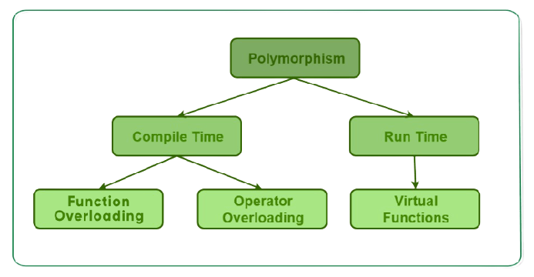
Types of polymorphism

Slide 4
Compile time polymorphism
This type of polymorphism is achieved by function overloading or operator overloading.

Slide 5
Function overloading
When there are multiple functions with same name but different parameters then these functions are said to be overloaded. Functions can be overloaded by change in number of arguments or/and change in type of arguments.

Slide 6
Operator Overloading
C++ also provide option to overload operators.
For example, we can make the operator (‘+’) for string class to concatenate two strings.
We know that this is the addition operator whose task is to add two operands. So a single operator ‘+’ when placed between integer operands , adds them and when placed between string operands, concatenates them.

Slide 7
Runtime polymorphism
This type of polymorphism is achieved by Function Overriding.
Function overriding on the other hand occurs when a derived class has a definition for one of the member functions of the base class. That base function is said to be overridden.

